Slide 1
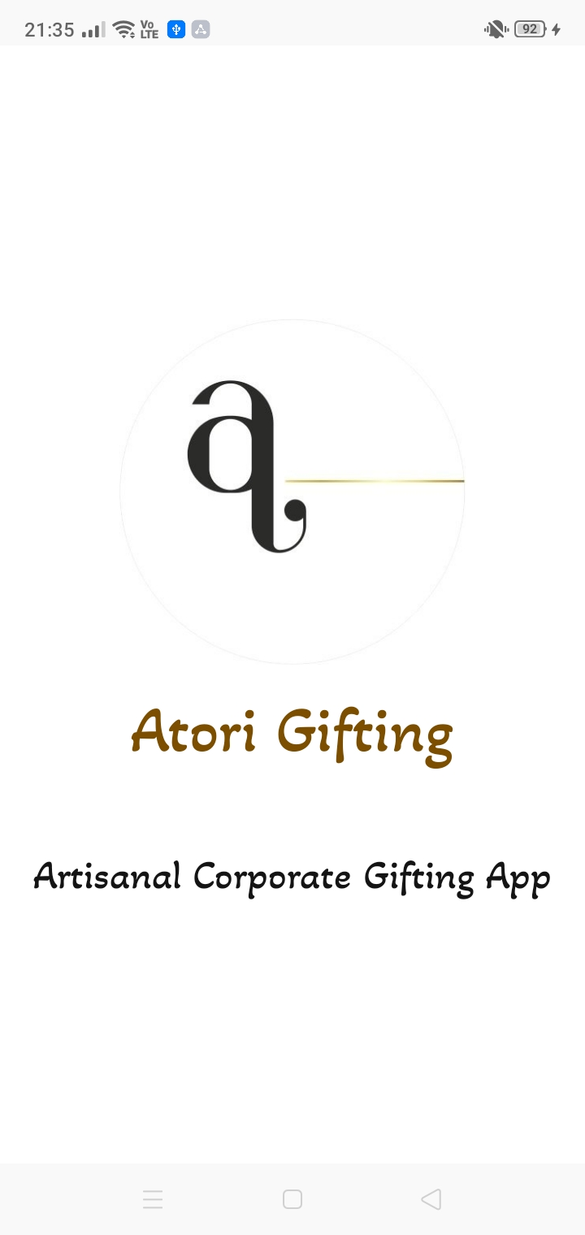
ATORI -:
THE ARTISANAL CORPORATE GIFTING APP

Slide 2

MEET THE
TEAM
For all client communications, we will be using the dedicated email address:
atorideveloper@gmail.com.
Ms.SIMIN KHAN
Project Guide
VEMAN S CHIPPA
MAHIMA CHOUDHARY
Team Lead
Team Lead
info.veman99@gmail.com
choudharymahima4075@gmail.com

Slide 3
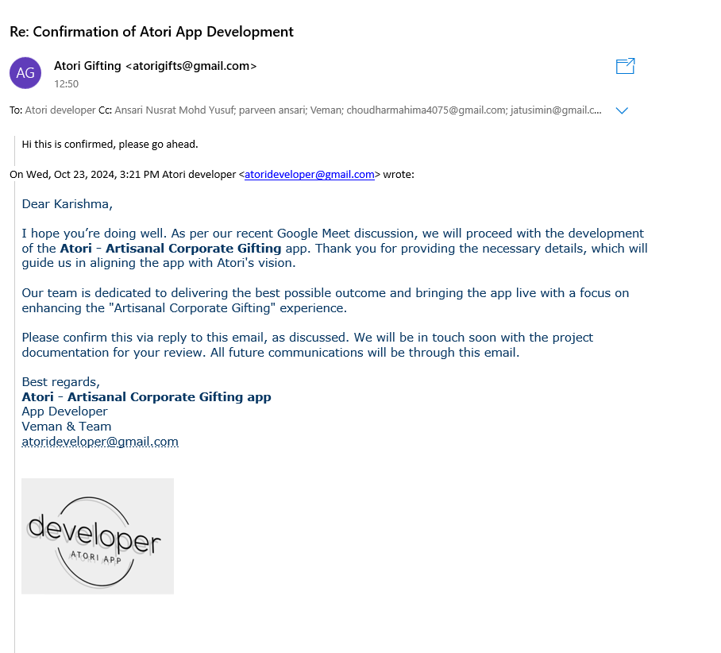
CLIENT’S CONFIRMATION FOR DEVLOPMENT OF APP

Slide 4

ABOUT
ATORI
Atori is a corporate gifting company that provides businesses with high-quality, curated gift options.
Focused on creating thoughtful and personalized experiences, Atori helps strengthen relationships, improve client retention, and boost employee morale through tailored corporate gifting solutions.

Slide 5
Objectives
The primary objective of the Atori app is to provide a comprehensive and user-friendly mobile platform that connects customers with a curated selection of innovative and eco-conscious products.
By offering an intuitive shopping experience through the client application and robust administrative controls via the admin application, Atori aims to streamline product discovery, order placement, and backend management.
The platform is committed to promoting sustainability and creativity while ensuring reliability, efficiency, and real-time interaction between users and administrators.

Slide 6
SCOPE
The Atori Android App provides a dual-interface platform designed for both users and administrators to efficiently manage the product discovery and order lifecycle.
It enables customers to explore and purchase innovative, eco-conscious products across multiple categories using a seamless, user-friendly interface.
Admins are empowered to manage the complete product catalog, user base, and order system, with real-time data handling through Firebase Firestore.

Slide 7
Problems in the Existing Atori System
The platform primarily relied on social media channels like Instagram and LinkedIn for showcasing products, which limited reach, interactivity, and scalability.
There was no dedicated mobile application to manage orders, products, or customer interactions, leading to inefficiencies in handling operations.
The absence of a centralized system made it hard to organize customer data, analyze trends, or provide personalized experiences.

Slide 8

TECHNOLOGY USED
Component | Details
Operating System for Application | Android
Language | Kotlin & Xml
Android Tools | Android Studio Koala 2024.1.1 (June 2024)
Database | Firebase Firestore
Browser | Chrome

Slide 9

BASIC MODULE
Module 1: Client Module
Sub-module 1: User Registration and Login - Form with secure login.
Sub-module 2: Reset Password UI (Forgot Password)
Sub-module 3: Product Browsing - Home, categories, product detail pages.
Sub-module 4: Cart and Checkout - Multi-step order process & cart management.

Slide 10
BASIC MODULE
Sub-module 4: Order Management - Add to cart, checkout, save to Firestore.
Sub-module 5: Promotional videos with fullscreen support.
Sub-module 6: Favorites - Add/remove products, stored in SharedPreferences.
Sub-module 7: Recommendations - Suggested products based on category

Slide 11
BASIC MODULE
Module 2: Admin Module
Sub-module 1: Admin Login
Login: Admin logs in securely to access the backend (Firebase Auth).
Sub-module 2: Product Management
View Products: All products from all categories shown in a single Recycler View.
Add Product: Add new products with fields (name, price, image, brand, etc.).
Edit Product: Update product details using Firestore document ID.
Delete Product: Remove a product permanently from Firestore.

Slide 12
BASIC MODULE
Sub-module 3 Order Management
View Orders: Admins can view all orders placed by clients.
Update Order Status: Change the status of orders (e.g., pending, shipped, confirm).
Manage Returns and Refunds: Process return requests and issue refunds as needed.
Sub-Module 4 User & Order Overview
View Total Users: Admin can see a complete list of all registered users.
View Total Orders: Admin has access to all orders placed by users

Slide 13
USE-CASE DIAGRAM

Slide 14
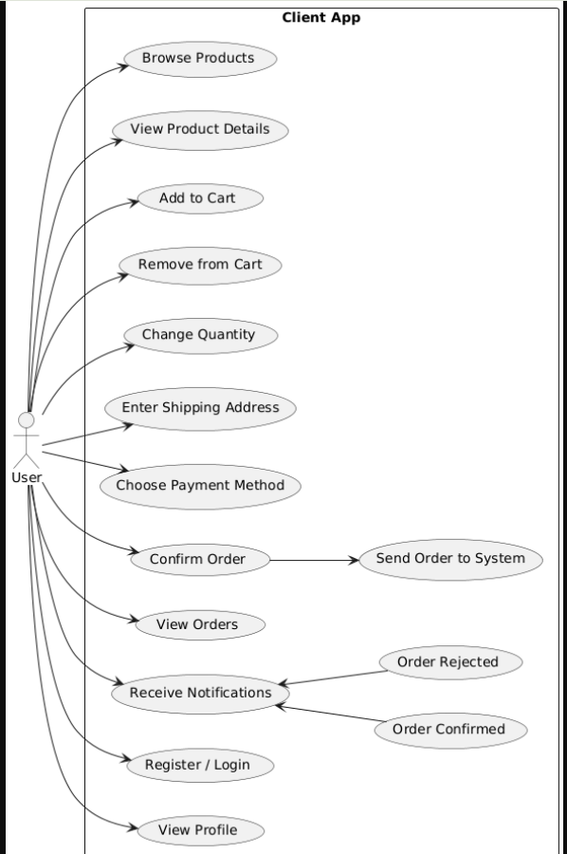
Client :----

Slide 15
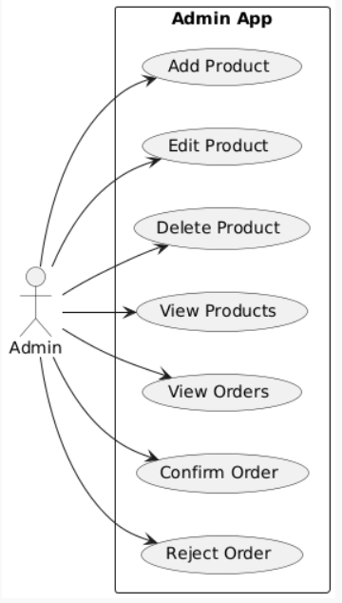
Admin:----

Slide 16
ACTIVITY DIAGRAM

Slide 17
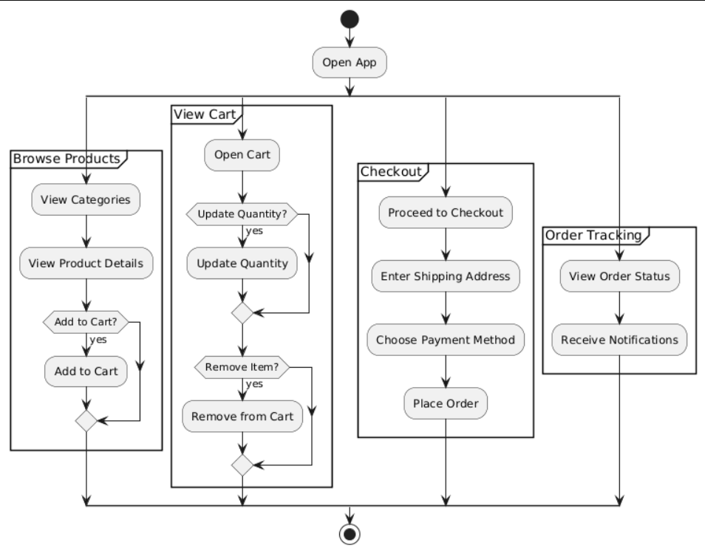
Client:----

Slide 18
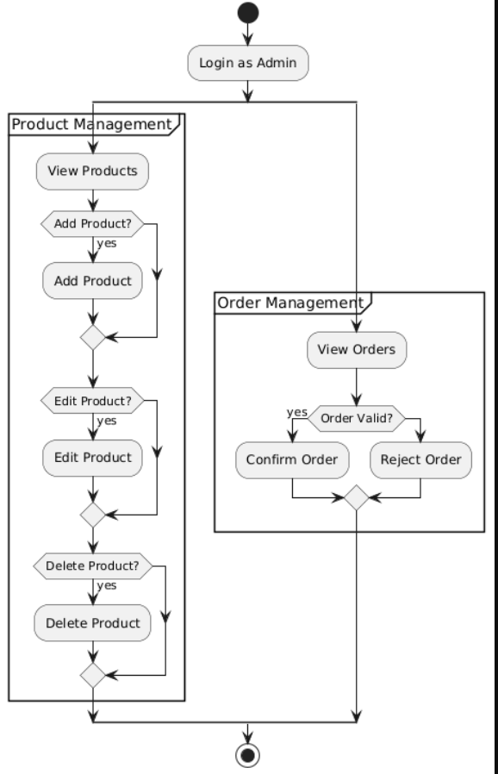
Admin:----
\

Slide 19
CLASS DIAGRAM

Slide 20
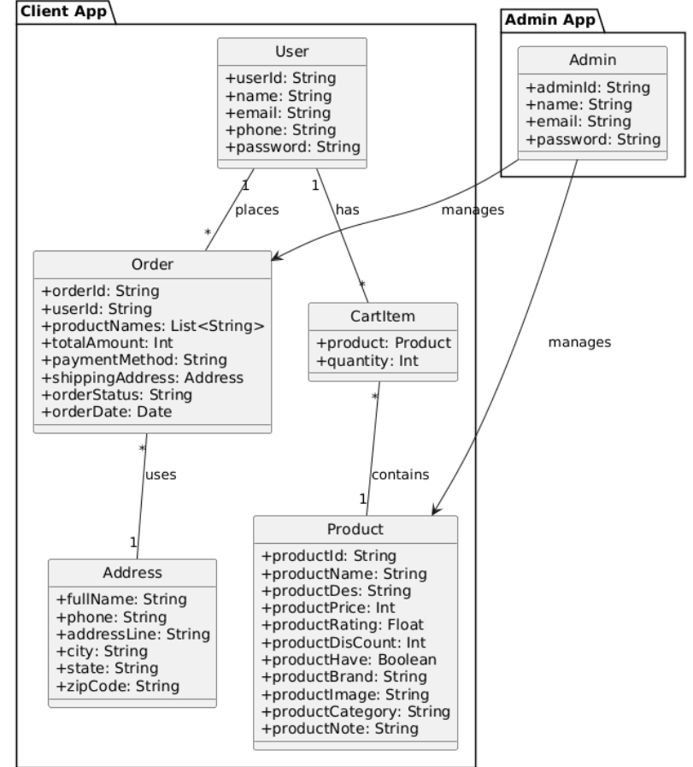
Client And Admin App:----
\

Slide 21
MODULE HIERARCHY
DIAGRAM

Slide 22
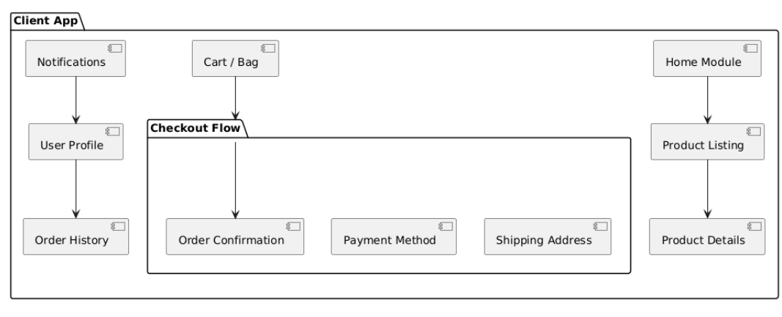
Client:----
\

Slide 23
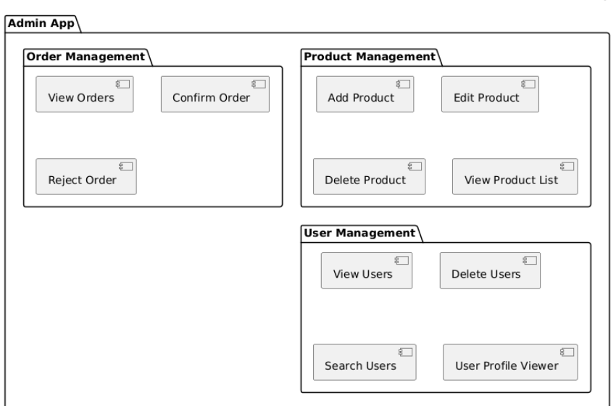
Admin:----

Slide 24
Firestore Authentication and Usage Overview

Slide 25
Firestore Authentication and Usage
User Registration using Email & Password
User Login/Logout functionality
Secure user session management
Authenticated access to user-specific data
Password Reset Feature: Users can securely reset their forgotten passwords via email using Firebase Authentication, ensuring account recovery without admin intervention.

Slide 26
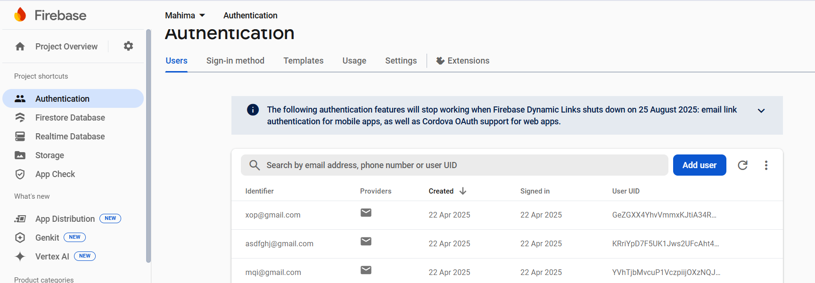

Slide 27
Firestore Usage in Atori
Products stored and managed in Firestore (Admin App)
Orders saved to Firestore from Client App
Admin views real-time order list from Firestore
Cart and Checkout process integrated with Firestore

Slide 28
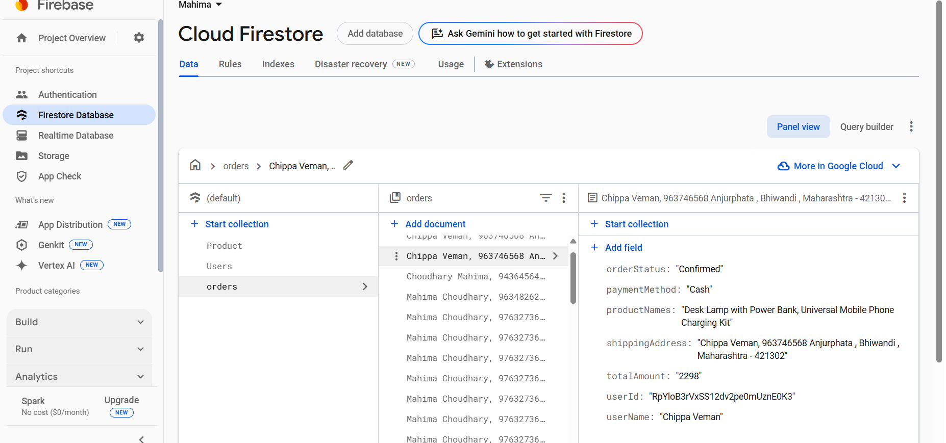

Slide 29
TEST CASES

Slide 30
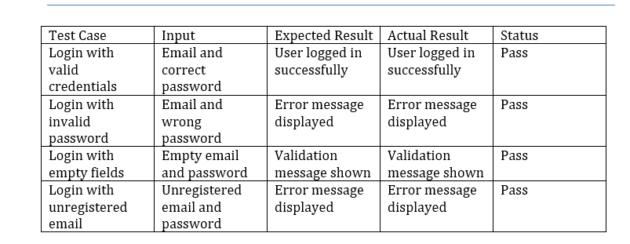
Login Page Test Cases

Slide 31
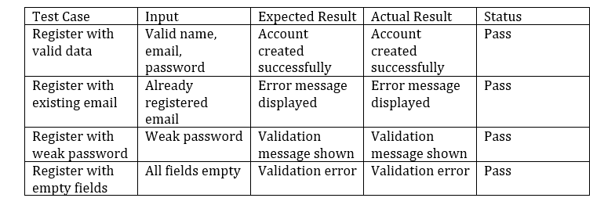
Register Page Test Cases

Slide 32
CLIENT INTERFACE DESIGN

Slide 33
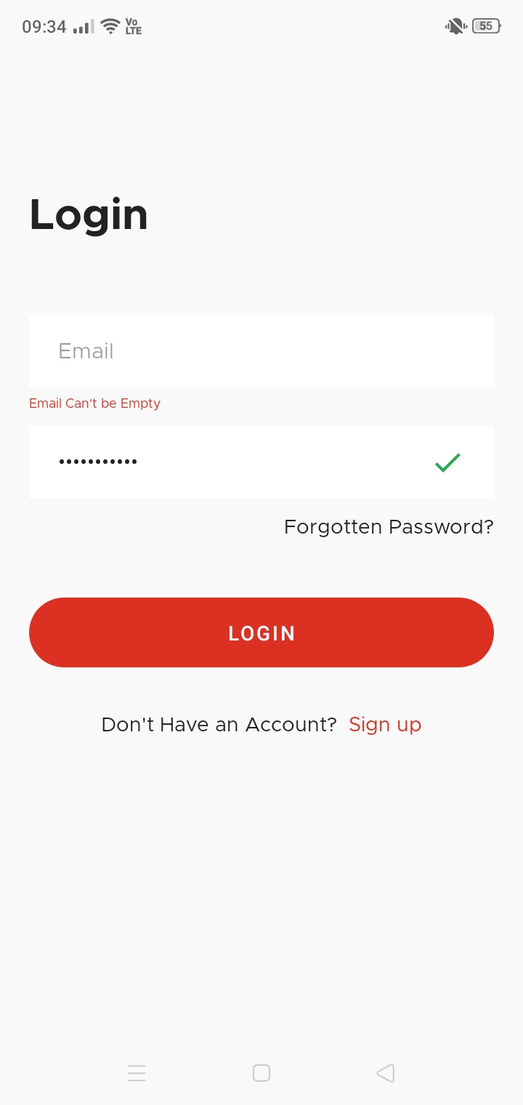
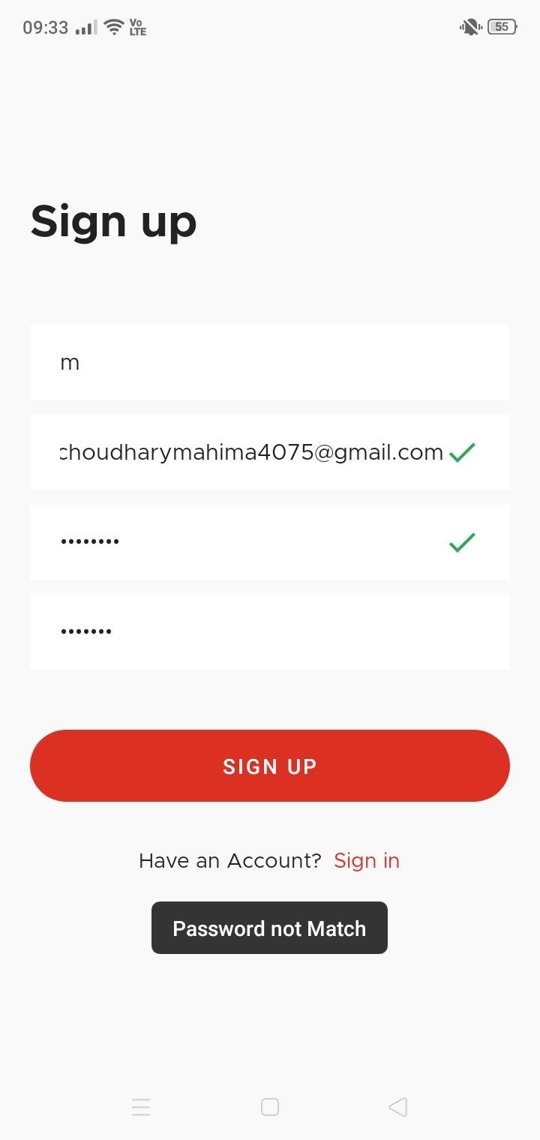
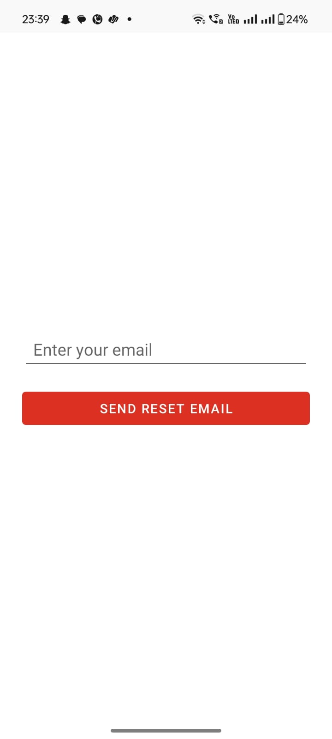

Slide 34
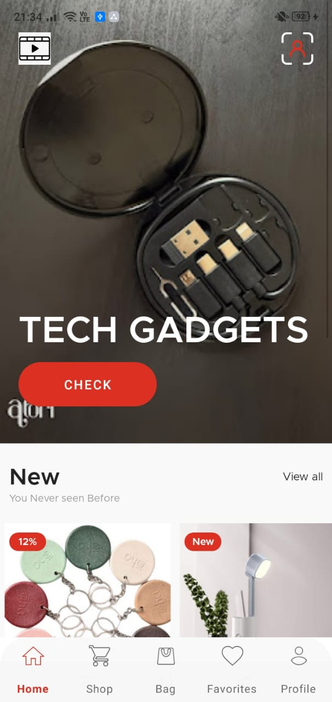
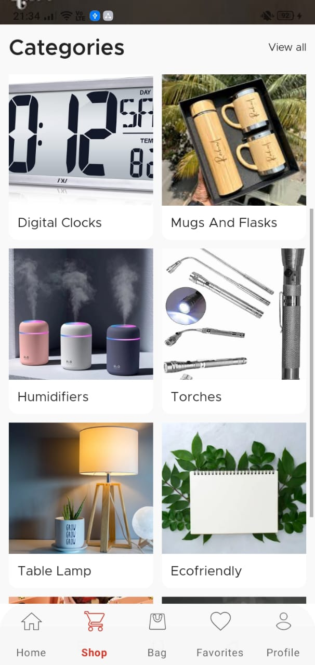
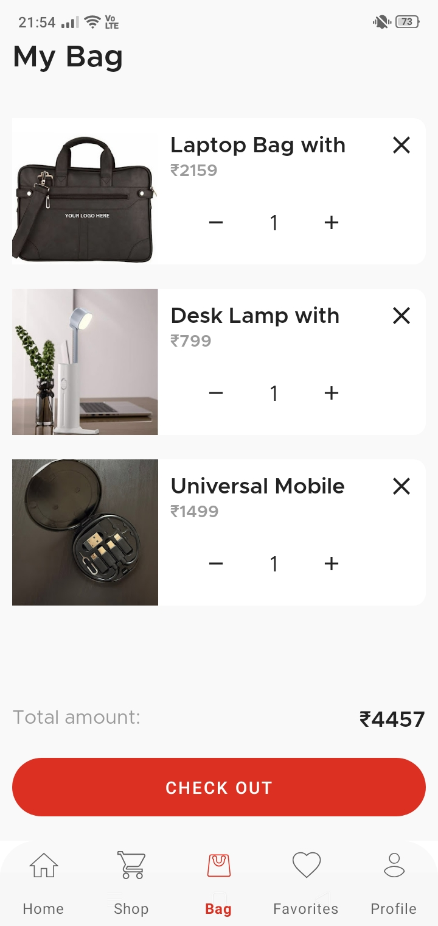

Slide 35
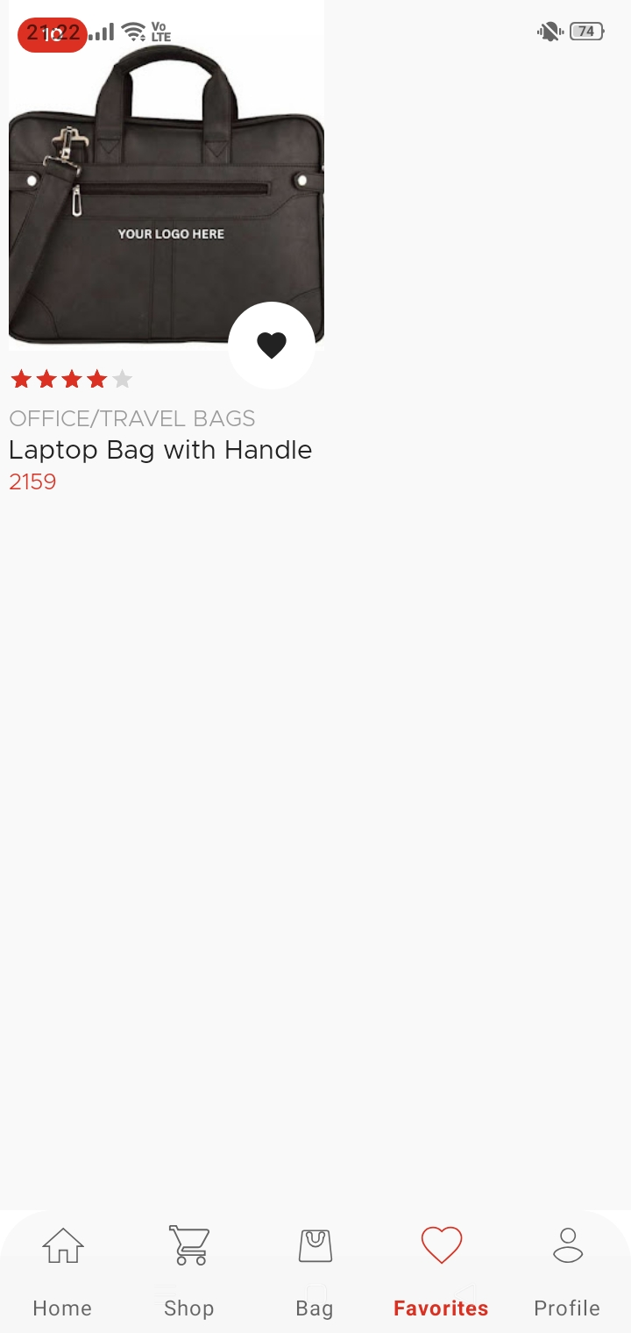
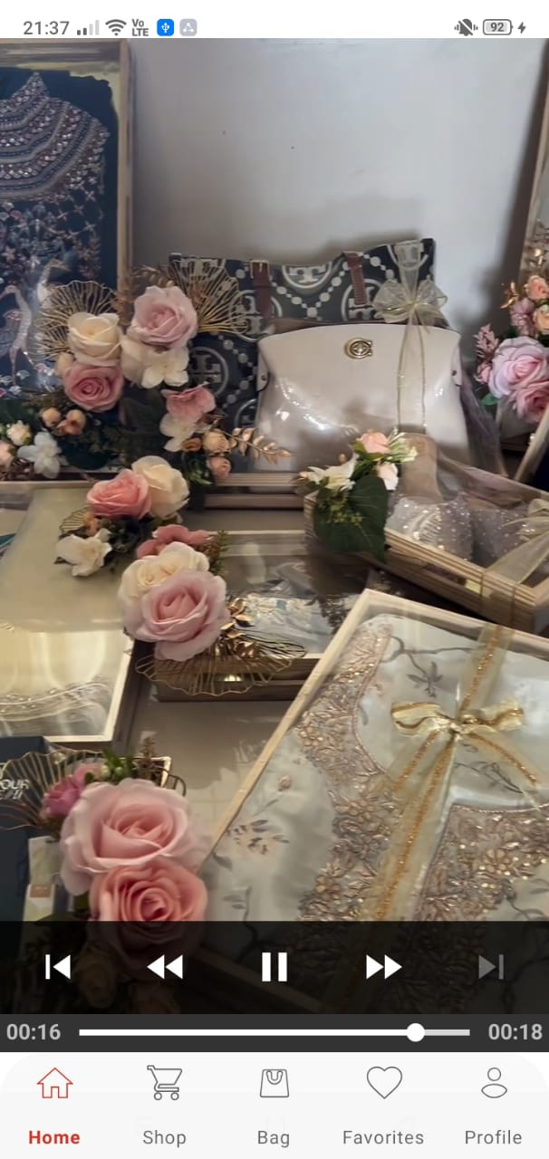

Slide 36
ADMIN INTERFACE DESIGN

Slide 37
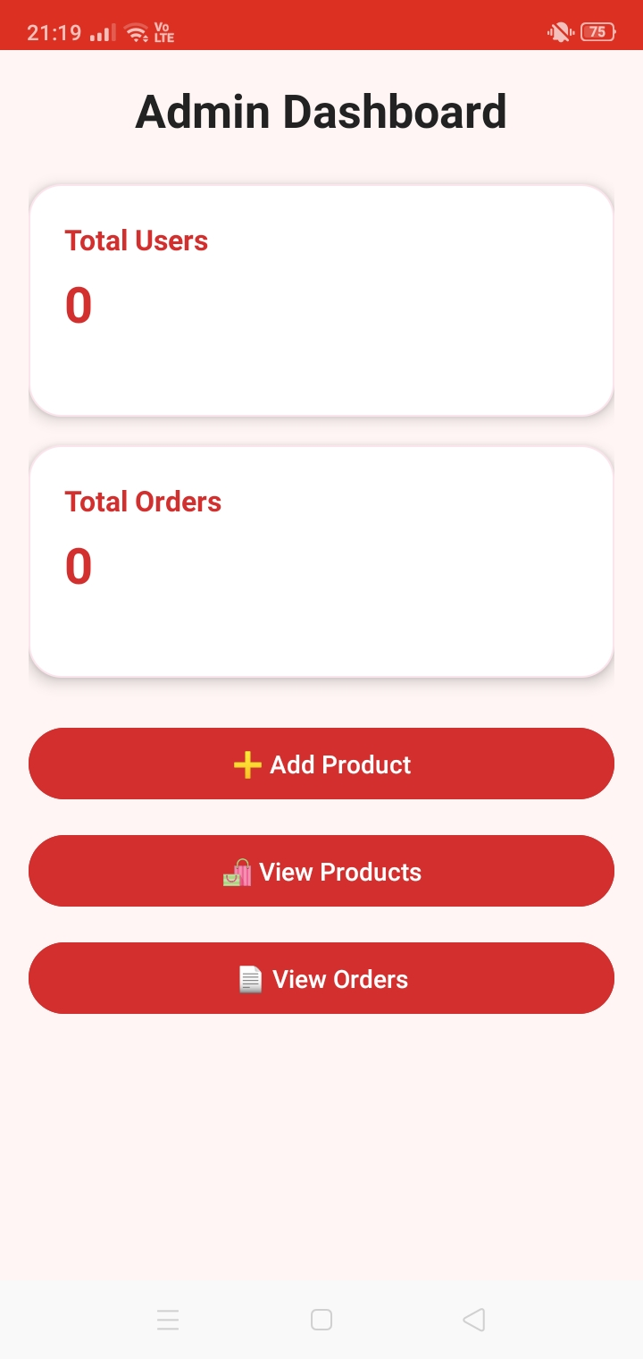
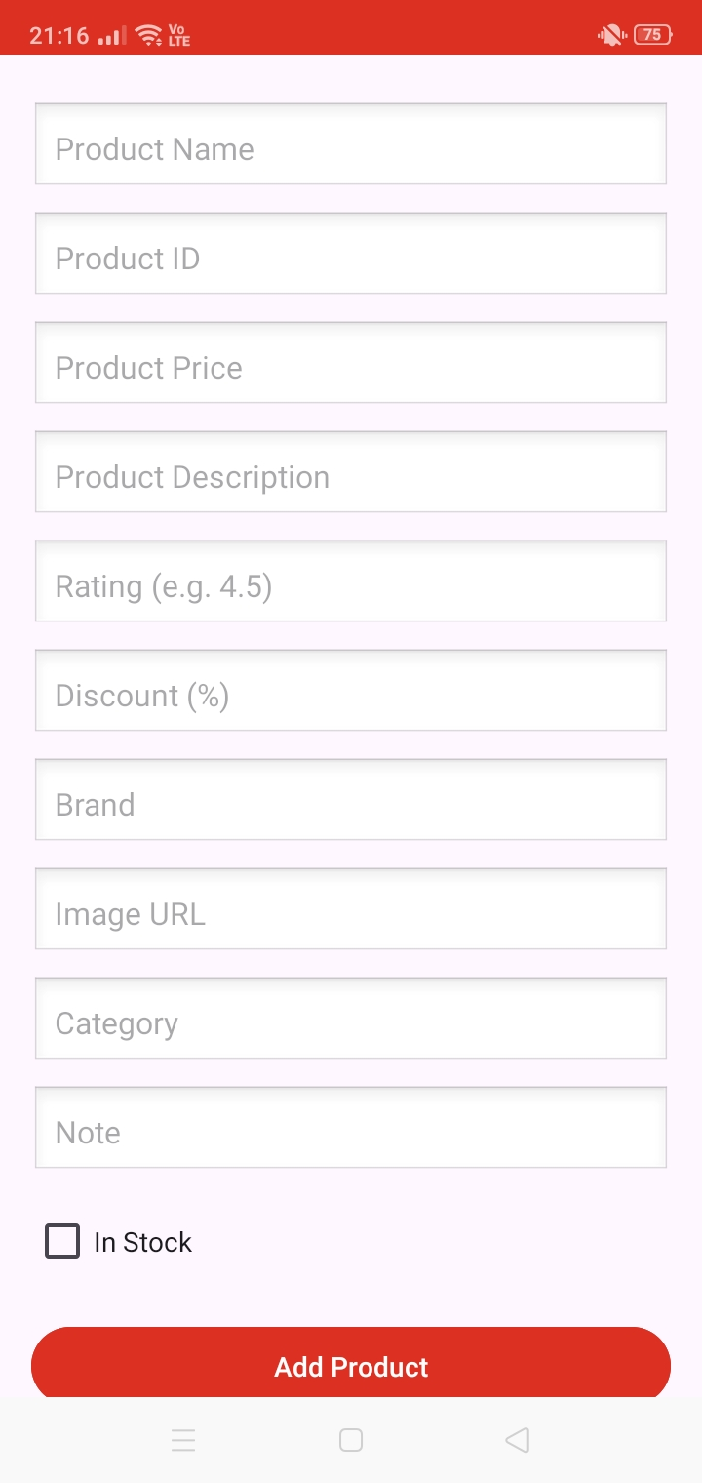
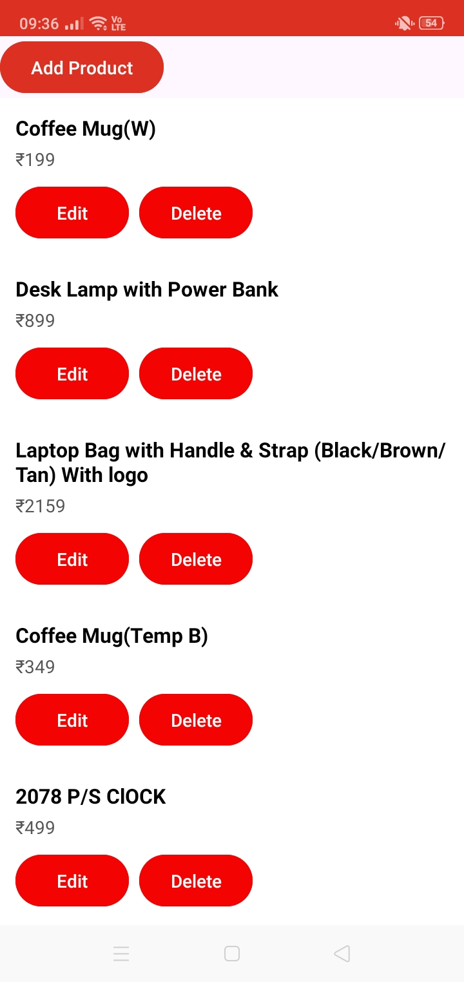

Slide 38
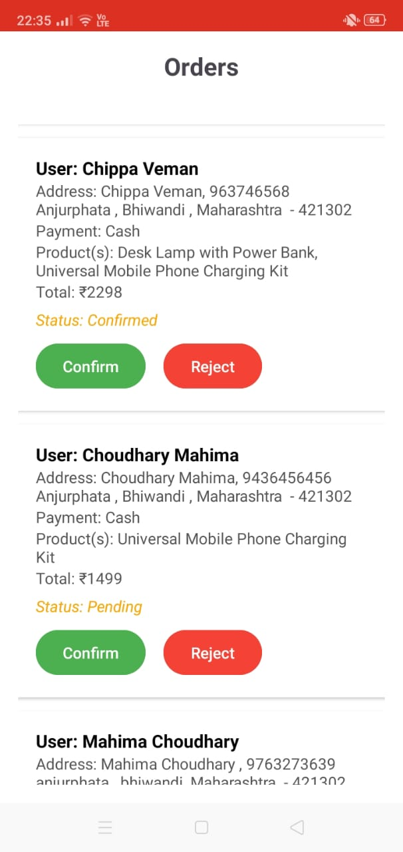

Slide 39
THANK
YOU
>

